Slide 1
“The Golden Eagles”

Slide 2
2023–’24
“The Golden Eagles”

Slide 3
2023–’24
“The Golden Eagles”
Last Take Offs

Slide 4
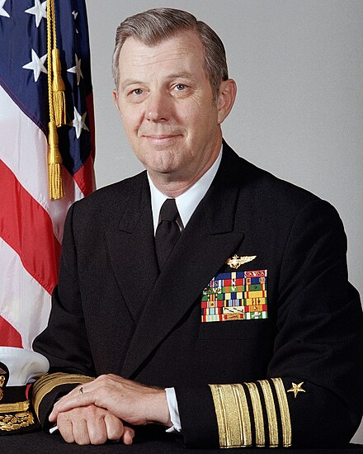
ADM James B. Busey IV, USN (Ret) April 21, 2023
Navy Cross

Slide 5
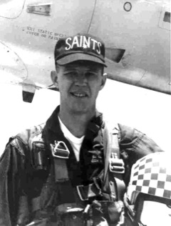
ADM James B. Busey IV, USN (Ret) April 21, 2023

Slide 6
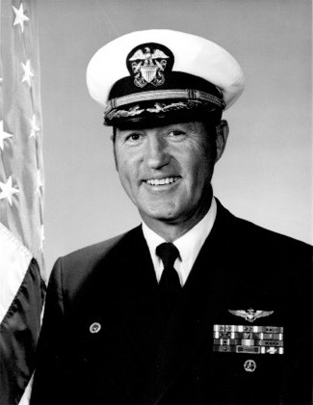
CAPT John “Jude” Lahr, USN (Ret) May 14, 2023
Distinguished
Flying
Cross
(4)

Slide 7
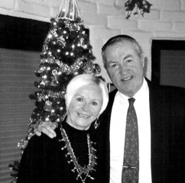
CAPT John “Jude” Lahr, USN (Ret) May 14, 2023

Slide 8
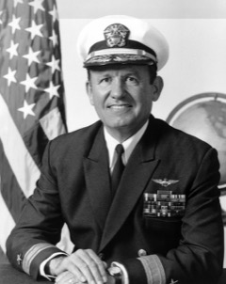
RDML Jimmie W. Taylor, USN (Ret) July 11, 2023
Legion
of
Merit

Slide 9
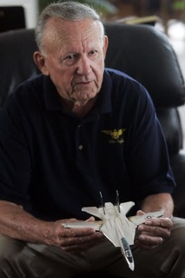
RDML Jimmie W. Taylor, USN (Ret) July 11, 2023

Slide 10
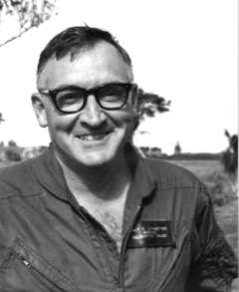
Col Walter R. Ledbetter, USMC (Ret) August 09, 2023
Navy Cross

Slide 11
Col Walter R. Ledbetter, USMC (Ret) August 09, 2023

Slide 12
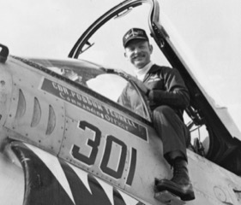
CAPT Jerry L. Terrell, USN (Ret) October 26, 2023
Legion
of
Merit

Slide 13
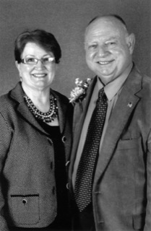
CAPT Jerry L. Terrell, USN (Ret) October 26, 2023

Slide 14
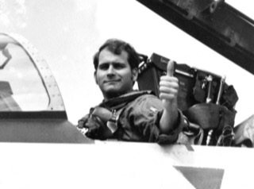
RADM James A. Robb, USN (Ret) November 01, 2023
Defense Distinguished
Service Medal

Slide 15
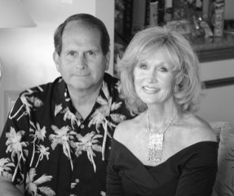
RADM James A. Robb, USN (Ret) November 01, 2023

Slide 16
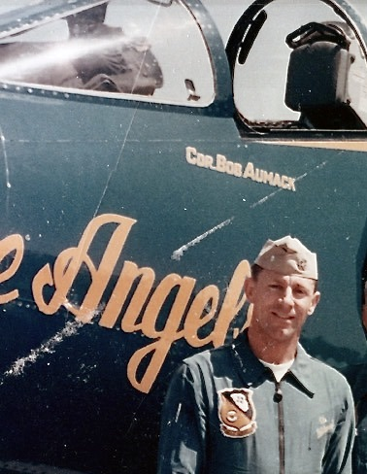
CDR Robert F. Aumack, USN (Ret) November 21, 2023
Distinguished
Flying
Cross
(3)

Slide 17
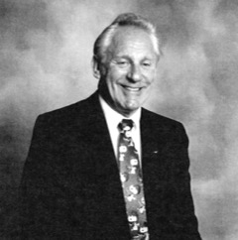
CDR Robert F. Aumack, USN (Ret) November 21, 2023

Slide 18
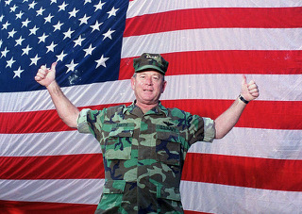
ADM Leighton W. Smith Jr., USN (Ret) November 28, 2023
Defense Distinguished
Service Medal

Slide 19
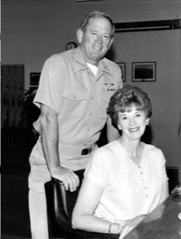
ADM Leighton W. Smith Jr., USN (Ret) November 28, 2023

Slide 20
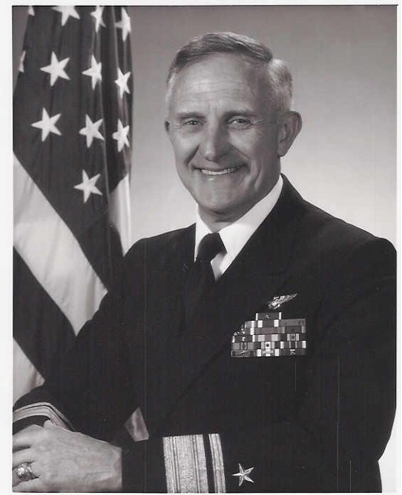
RADM William E. Newman, USN (Ret) December 04, 2023
Distinguished
Service
Medal

Slide 21
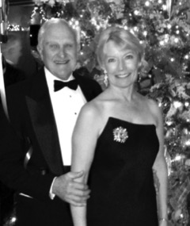
RADM William E. Newman, USN (Ret) December 04, 2023

Slide 22
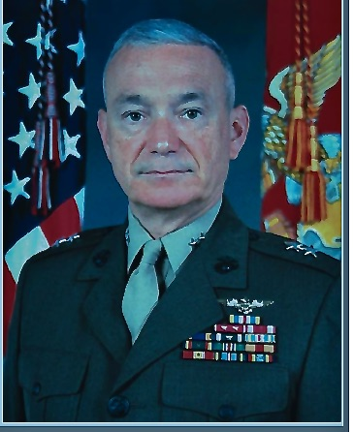
MajGen Dennis T. Krupp, USMC (Ret) December 05, 2023
Distinguished
Service
Medal

Slide 23
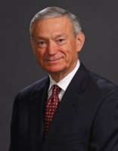
MajGen Dennis T. Krupp, USMC (Ret) December 05, 2023

Slide 24
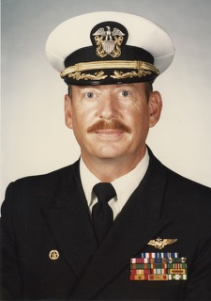
CAPT Robert E. Tucker Jr., USN (Ret) December 16, 2023
Silver Star

Slide 25
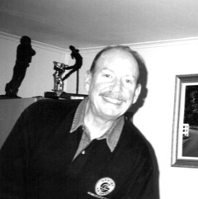
CAPT Robert E. Tucker Jr., USN (Ret) December 16, 2023

Slide 26
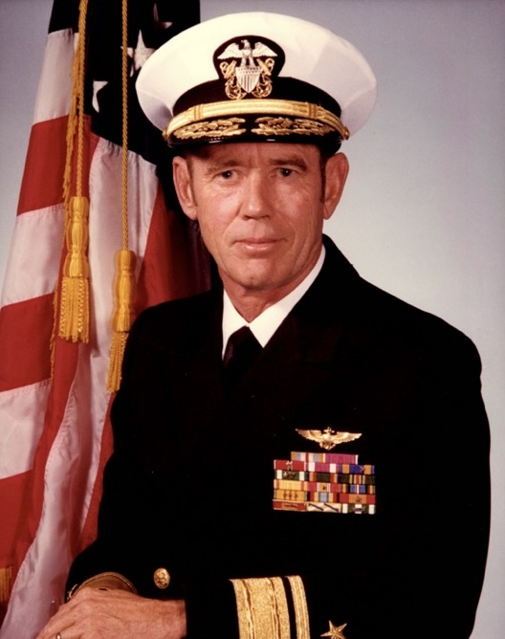
RADM George A. Aitcheson, USN (Ret) January 25, 2024
Defense Superior Service Medal

Slide 27
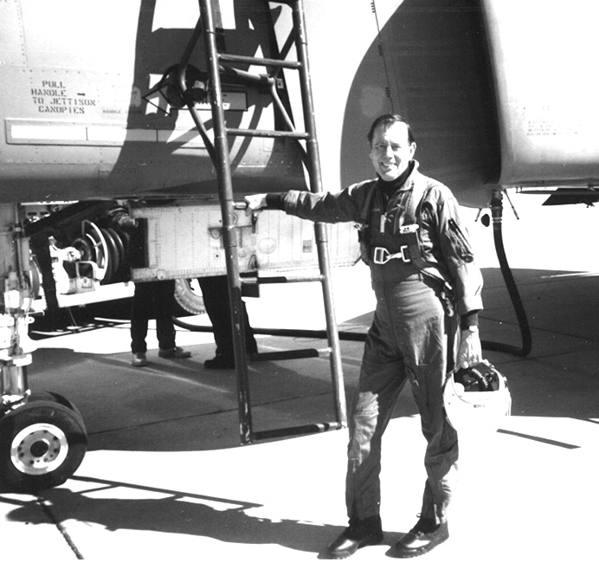
RADM George A. Aitcheson, USN (Ret) January 25, 2024

Slide 28
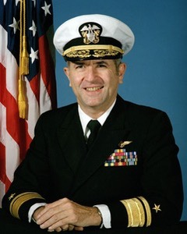
VADM Richard H. Truly, USN (Ret) February 27, 2024
Defense Superior Service Medal

Slide 29
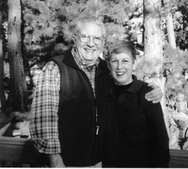
VADM Richard H. Truly, USN (Ret) February 27, 2024

Slide 30
Golden Eagle Spouses/Widows
Kay Knutson May 20, 2023
Gay Boecker June 18, 2023
Sharon Ruliffson August 02, 2023
Barbara Tuttle August 25, 2023
Marilyn Lovell August 27, 2023
Joan Giuliani September 19, 2023
Nicole Sullivan November 22, 2023

Slide 31
Golden Eagle Spouses/Widows
Mitch Tinker January 19, 2024
Loretta Penn February 27, 2024
Amante Carlquist March 20, 2024

Slide 32
God bless them all … each one an American original

Slide 34
Eulogies

Slide 35
ADM James B. Busey IV, USN (Ret) April 21, 2023

Slide 36
CAPT John “Jude” Lahr, USN (Ret) May 14, 2023

Slide 37
RDML Jimmie W. Taylor, USN (Ret) July 11, 2023

Slide 38
Col Walter R. Ledbetter, USMC (Ret) August 09, 2023

Slide 39
CAPT Jerry L. Terrell, USN (Ret) October 26, 2023

Slide 40
RADM James A. Robb, USN (Ret) November 01, 2023

Slide 41
CDR Robert F. Aumack, USN (Ret) November 21, 2023

Slide 42
ADM Leighton W. Smith Jr., USN (Ret) November 28, 2023

Slide 43
RADM William E. Newman, USN (Ret) December 04, 2023

Slide 44
MajGen Dennis T. Krupp, USMC (Ret) December 05, 2023

Slide 45
CAPT Robert E. Tucker Jr., USN (Ret) December 16, 2023

Slide 46
RADM George A. Aitcheson, USN (Ret) January 25, 2024

Slide 47
VADM Richard H. Truly, USN (Ret) February 27, 2024

